Slide 1

Digitalization in Forvis Mazars
2026

Slide 2
Content
Forvis Mazars
Digital Tools & Solutions
Our team

Slide 3

Forvis Mazars
01

Slide 4

Forvis Mazars
At a glance
100+
1,800+
countries and territories
combined partners
€5bn+
40,000+
revenue*
combined professionals
All figures relate to Forvis Mazars, the brand name for the Forvis Mazars Global network (Forvis Mazars Global Limited) and its two independent members: Forvis Mazars Group SC, an internationally integrated partnership operating in over 100 countries and territories and Forvis Mazars LLP in the United States.
* Combined figures: Forvis Mazars Group €3bn + Forvis Mazars, LLP €2bn as at 31 August 2025

Slide 5
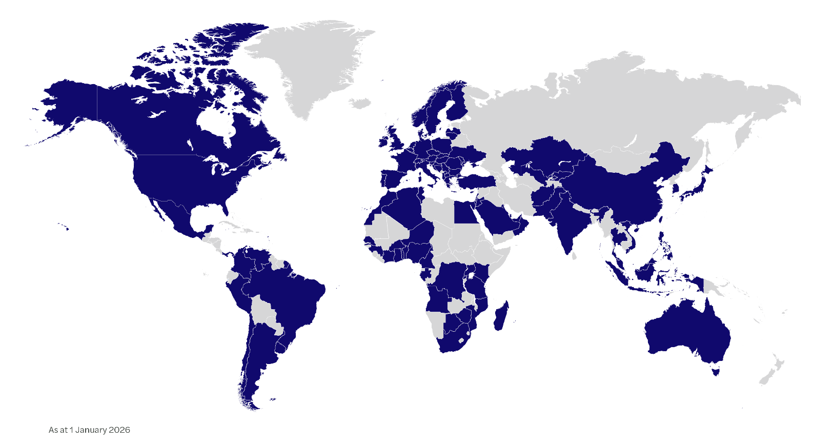
Forvis Mazars
As of 1 January 2026
€5bn+
revenue*
100+
countries and territories
1,800
partners
40,000+
professionals
All figures relate to Forvis Mazars, the brand name for the Forvis Mazars Global network (Forvis Mazars Global Limited) and its two independent members: Forvis Mazars Group SC, an internationally integrated partnership operating in over 100 countries and territories and Forvis Mazars LLP in the United States.
* Combined figures: Forvis Mazars Group €3bn + Forvis Mazars, LLP €2bn as at 31 August 2025

Slide 6
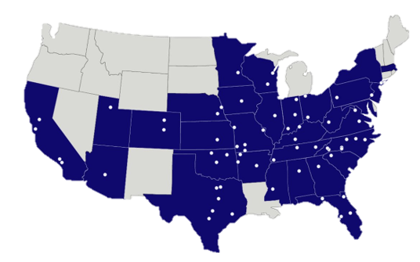
Forvis Mazars in the U.S.
Figures valid for Forvis Mazars LLP in the US, as at 31 August 2025
7,000+
600+
professionals
partners
US$2.3bn
74
fee income
offices
Forvis Mazars offices
Forvis Mazars is the brand name for the Forvis Mazars Global network (Forvis Mazars Global Limited) and its two independent members: Forvis Mazars LLP in the United States and Forvis Mazars Group SC, an internationally integrated partnership operating in over 100 countries and territories.

Slide 7
Forvis Mazars in the Czech Republic
At a glance
€16,3m
10
fee income*
(financial year: 1 September 2024 – 31 August 2025)
partners
260+
1
professionals to serve clients
office
*Fee income for Forvis Mazars in the Czech Republic
Figures as at 1 September 2025 unless otherwise stated

Slide 8



Our services
Audit
  Audit of financial statement (according to Czech accounting legislation, IFRS, US GAAP, etc.)
  Statutory audit
  Contractual audit
  Audit of consolidated financial statements
  Agreed procedures
  Preparation of financial statements in accordance with International Financial Reporting Standards
  Verification in projects for transforming the company
  Accounting methodology advisory
  Internal audit
Tax
  Tax advisory for legal entities
  Tax advisory for individuals
  Indirect taxation
  Transfer prices
  Representation and Handling of Disputes
  Personal and corporate income tax returns (preparation, support, submission)
Outsourcing
  Outsourcing accounting
  Accounting advisory services
  Outsourcing of business processes
  BPO
  Temporary accounting services
  Consolidation and reporting
  Working capital optimization
  SAP implementation support
  Support in starting a new business

Slide 9



Our services
Transaction advisory
  Investment audit of the target company - financial and tax due diligence
  Organization of the sale process of the company
  Support in negotiating a contract for the purchase of ownership shares
  Advice on choosing suitable structures for mergers and divisions, or organization of the business transformation process
Valuation / Appraisal
  Valuation in a connection with business transformations, business transactions, non-cash deposits
  Valuation of real estate and other assets (for example, for financial reporting purposes)
  Preparation of financial plans and valuations for bank financing purposes (including collateral)
Technology & Digital Consulting
  Customized solutions that grow with you, keeping your data safe and secure
  Our digital tools make work faster and smarter, helping you connect with customers and suppliers.
  Business intelligence
  Reporting solution that provides genuine insight
  Analysis of internal procedures, accounting processes and identification of "problem" areas
  Automation and digitalization of processes
  Review of existing tools and suggestions for possible automation
  ERP implementation
  Business process improvement
  Identifying opportunities for outsourcing or shared services
  Project management and change management services to support the transition to improved processes
  Customized training

Slide 10



Our services
Payroll
  Payroll processing, including tax-related matters
  Management of payroll-related payments
  Communication with authorities and processing of all legal documentation
  HR administration and HR consulting
  International payroll management, reporting
  Digitization - Payroll/accounting integration
  Madison - a modern application for managing documents and tax forms
HR consulting, equal pay and Equal Salary certification
  HR compliance (setting up or reviewing HR processes)
  Grading structure, setting up job families, job catalog
  Benchmarking
  Payroll audit (setting up payroll processes)
  Support in the area of mandatory reporting in accordance with EU Directive No. 2023/970 on equal and transparent remuneration
  Calculation of the Gender Pay Gap and proposal of corrective measures, including a financial budget
  Verification of the GPG and issuance of a report for suppliers
  Authorization to perform audits leading to Equal Salary certification guaranteed by a prestigious Swiss foundation
Responsible Business and Sustainability
  Implementation of applicable ESG legislation into the company's internal processes
  Preparation of a double materiality analysis
  Mapping of the value chain
  Climate risk assessment
  Determination of the scope of relevant ESG topics for reporting
  EU Taxonomy
  Preparation of a sustainability report
  Training on responsible business and ESG legislation

Slide 11
Digital Tools & Solutions
02

Slide 12

Digital Tools & Solutions
Innovation & Technology in CZ
Local Technology & Innovation team
Drives adoption of new technologies and digital tools.
Supports development of internal and client-facing solutions.
Collaborates across departments to accelerate digital transformation.

Slide 13

Digital Tools & Solutions
Digitalization & Automation Services
Helping organizations streamline internal processes
Analysis of internal procedures and identification of inefficiencies.
Review of current tools and suggestions for automation.
Process benchmarking across industries.
Development of KPI frameworks and support in change management.

Slide 14

Digital Tools & Solutions
Business Process Improvement
Data-driven optimization of company processes
Implementation of robotic process automation (RPA) reducing administrative costs.
Machine learning solutions accelerating audit and document review.
Designing digital strategies for innovation and long-term growth.
Helping organizations unlock value from their data using analytics and visualization.

Slide 15

Digital Tools & Solutions
Madison: Digital HR Solution
HR portal for employees, managers and payroll teams
Secure storage and access to payroll documentation.
User-friendly digital forms including Taxpayer Declaration.
Multi-device support (PC, tablet, mobile).
Roadmap: annual tax statement, new languages, full HR portal capabilities.

Slide 16

Digital Tools & Solutions
Helios iNuvio Partnership
Authorized Implementation Partner
Forvis Mazars Consulting is an Authorized Implementation Partner of HELIOS iNuvio.
Certified expertise in implementation of Helios iNuvio ERP system.
Seamless combination of financial, accounting and IT know-how.
Enhanced ability to support clients in digital transformation and ERP projects.

Slide 17

Digital Tools & Solutions
HR portal for employees, managers and payroll teams
AVAplace Partnership
AVA Applications – flexible business apps tailored to client needs
AVAplace is a cloud-based business application platform offering a curated portfolio of enterprise applications for HR, finance, logistics, productivity, compliance and other business areas.
Applications can extend Helios ERP, but can also be used independently, depending on client needs and system landscape.
As an AVA partner, Forvis Mazars helps clients:
Identify suitable applications based on their role, profession and business processes.
Select solutions that work with or without Helios ERP, depending on the client’s environment.
Combine ERP systems with specialized business apps without custom development.
Adopt applications that best fit their profession (e.g. finance, HR, logistics, management), not a single technology stack.
Applications are available via AVAstore and are designed to be secure, cloud-based and easy to adopt, whether integrated with Helios or used as standalone tools.

Slide 18
Our team
03

Slide 19


Our team
Partners for digitalization
Monika Drábová
+420 725 530 505
Partner, Technology & Digital Consulting
monika.drabova@forvismazars.com
Monika Drábová has many years of experience in the area of accounting outsourcing and consulting. She currently leads the Technology & Digital Consulting service line at Forvis Mazars, where she focuses on financial process digitalization and automation, ERP consulting, and business process optimization for clients across various industries.
She has deep expertise in accounting system implementations (particularly Helios, IFS, and others), shared service center (SSC) setups, international BPO project management.
She holds a Master’s degree from the University of Economics in Prague, Faculty of Finance and Accounting. She is a member of the Association of Chartered Certified Accountants (ACCA, Advanced Diploma in Accounting and Business) and a Certified Executive Accountant with the Chamber of Certified Accountants in the Czech Republic.
Iva Leksová
+420 725 721 869
Business Process Analyst
iva.leksova@forvismazars.com
Iva Leksová has of experience in the area of accounting and outsourcing. Currently her focus is concentrated on identification of company’s processes and research of possible automations. She is also key user and consultant of accounting software Helios, Docu-X (OCR) and Madison.
She graduated on University of Economics in Prague, Faculty of Finance and Accounting. She speaks Czech and English.
In her current position, she is responsible for analysis of company’s processes and tools and is part of Technology & innovation team.

Slide 20
Port7
Pod dráhou 1637/4,
170 00 Prague 7
Czech Republic
Forvis Mazars Group SC is an independent member of Forvis Mazars Global, a leading professional services network. Operating as an internationally integrated partnership in over 100 countries and territories, Forvis Mazars Group specialises in audit, tax and advisory services. The partnership draws on the expertise and cultural understanding of over 40,0000 professionals across the globe to assist clients of all sizes at every stage in their development. Forvis Mazars in the Czech Republic is part of the Forvis Mazars Group SC. Visit forvismazars.com/cz to learn more.
The contents of this document are confidential and not for distribution to anyone other than the recipients. Disclosure to third parties cannot be made without the prior written consent of Forvis Mazars Group SC.

